Slide 1


Slide 2


Slide 3
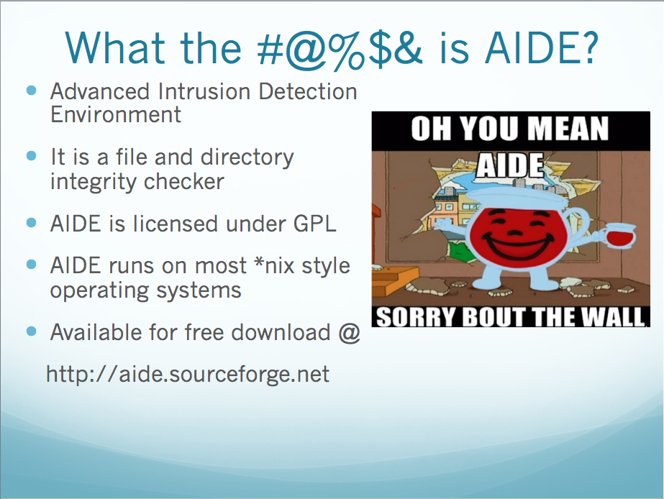

Slide 4
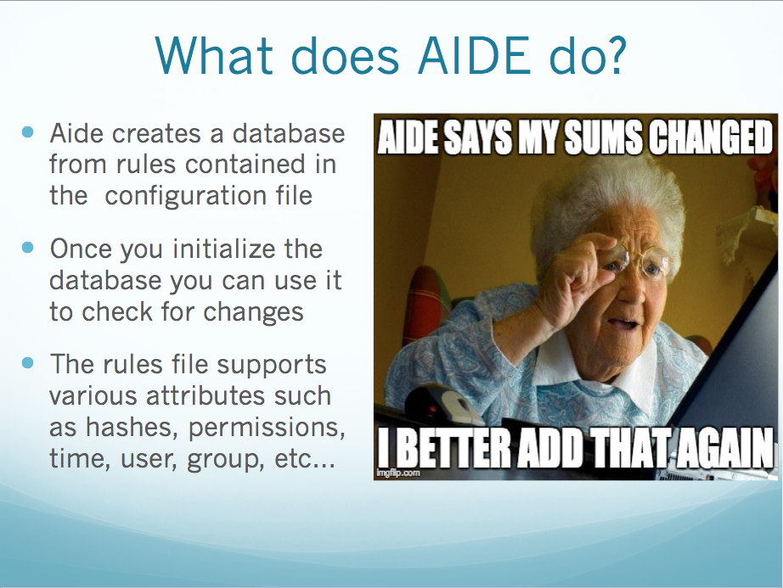

Slide 5
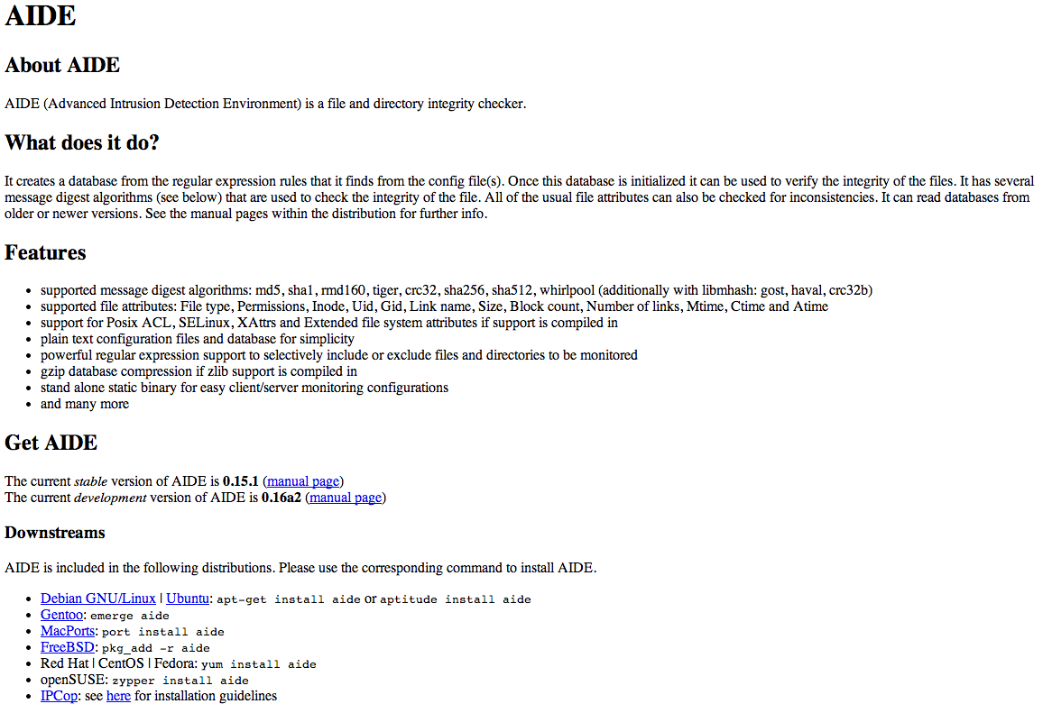

Slide 6
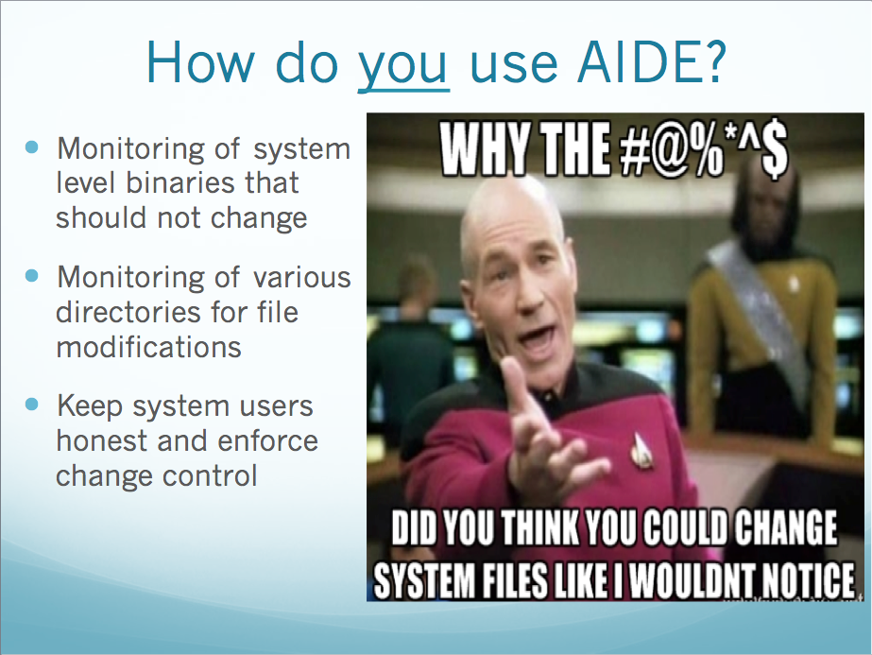

Slide 7
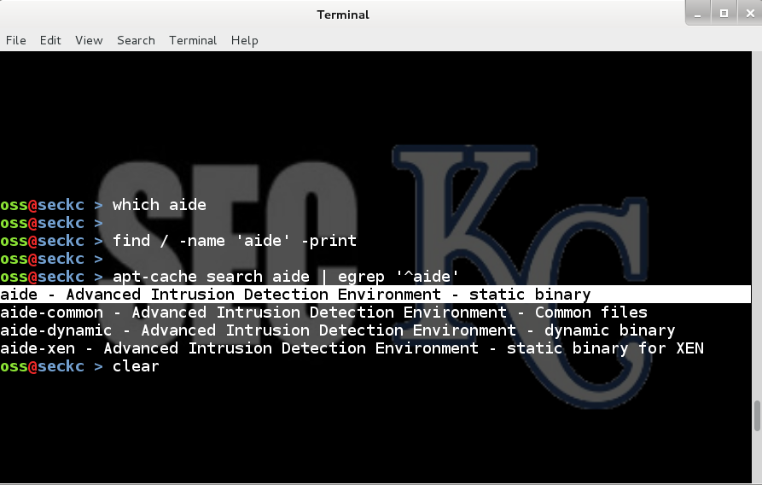
Is AIDE in Kali ?

Slide 8
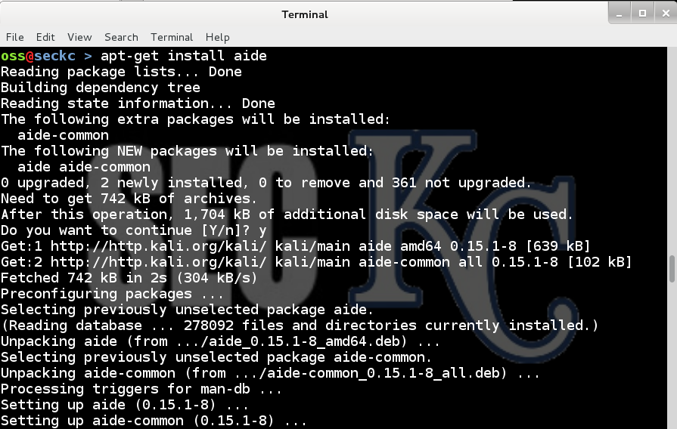
Installing AIDE on Kali

Slide 9


Slide 10
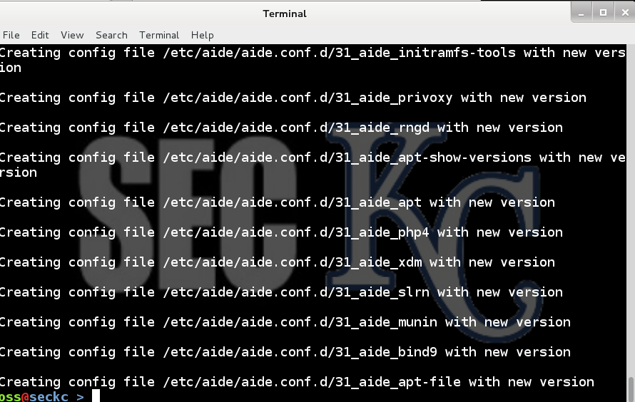
Installing AIDE on Kali

Slide 11
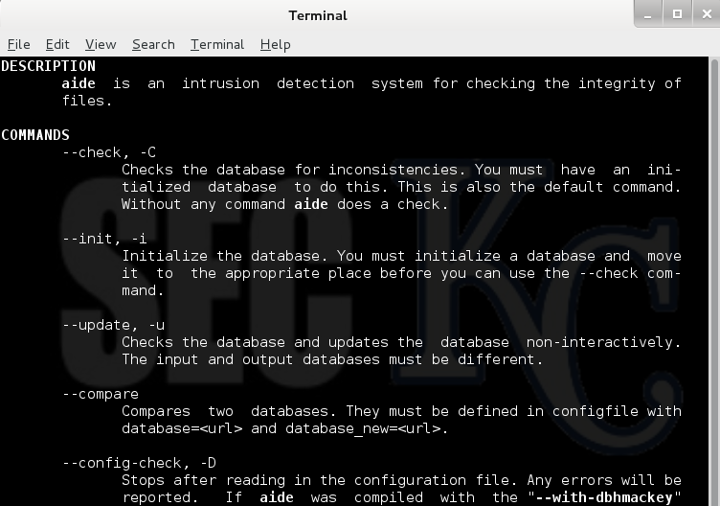
AIDE MAN PAGE

Slide 12
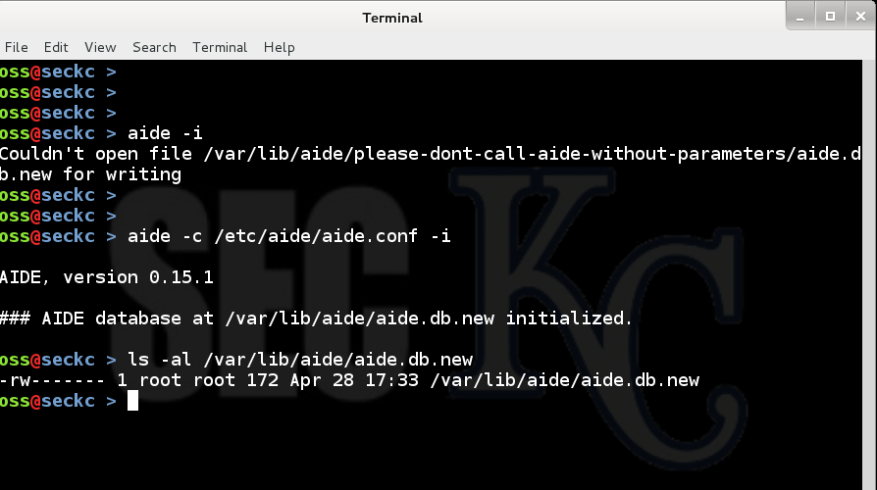
Running AIDE for the 1st time

Slide 13
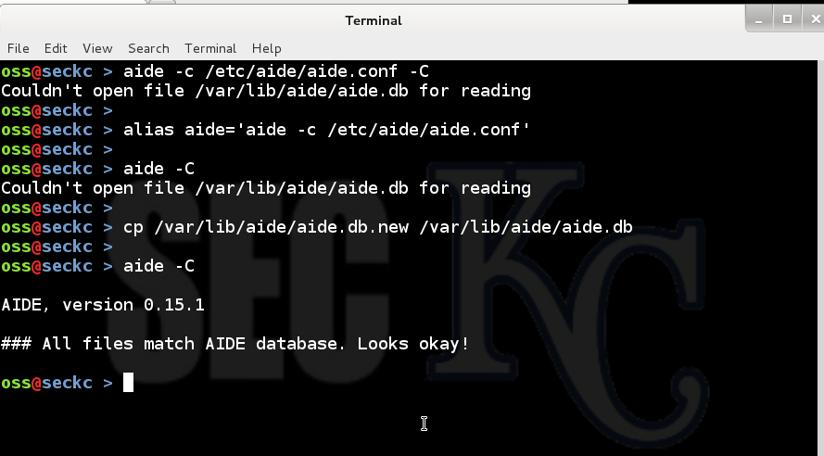
AIDE first check

Slide 14
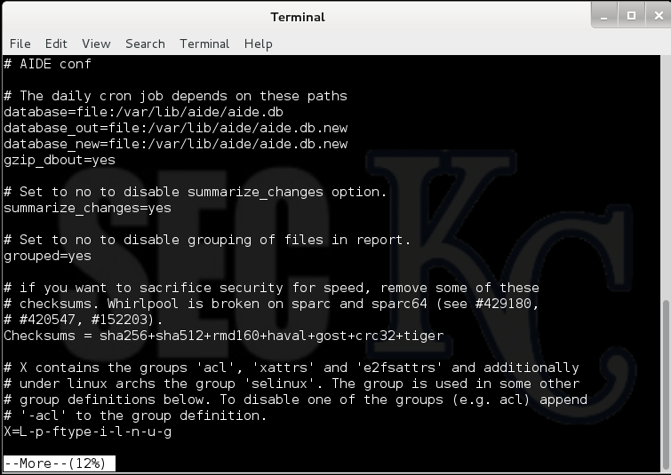
AIDE CONFIG FILE

Slide 15
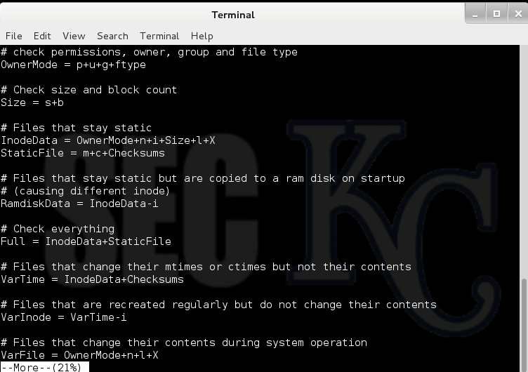
AIDE CONFIG FILE

Slide 16
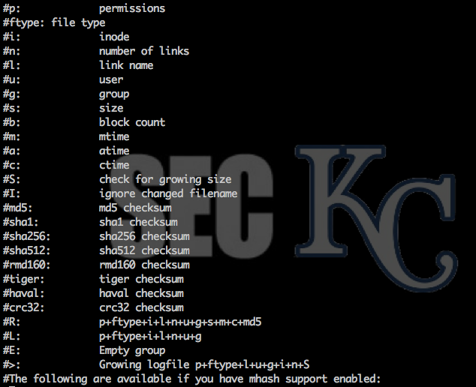
AIDE CONFIG FILE

Slide 17
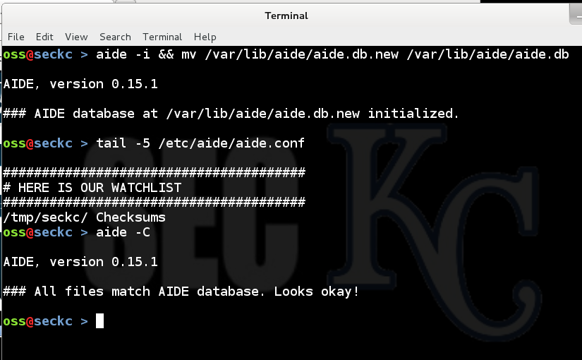
AIDE first watch

Slide 18


Slide 19
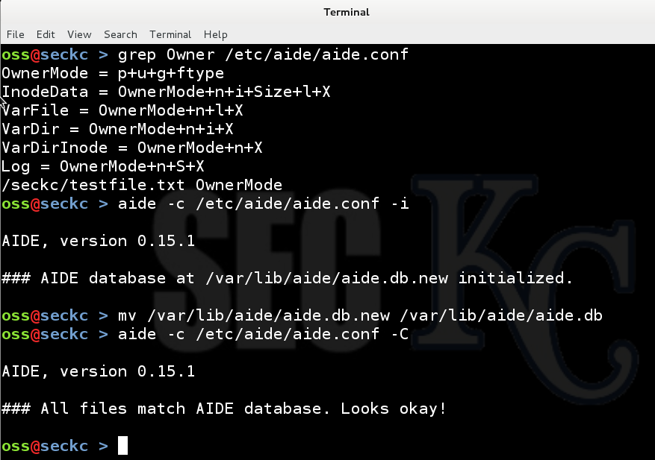
AIDE OWNER MODE

Slide 20
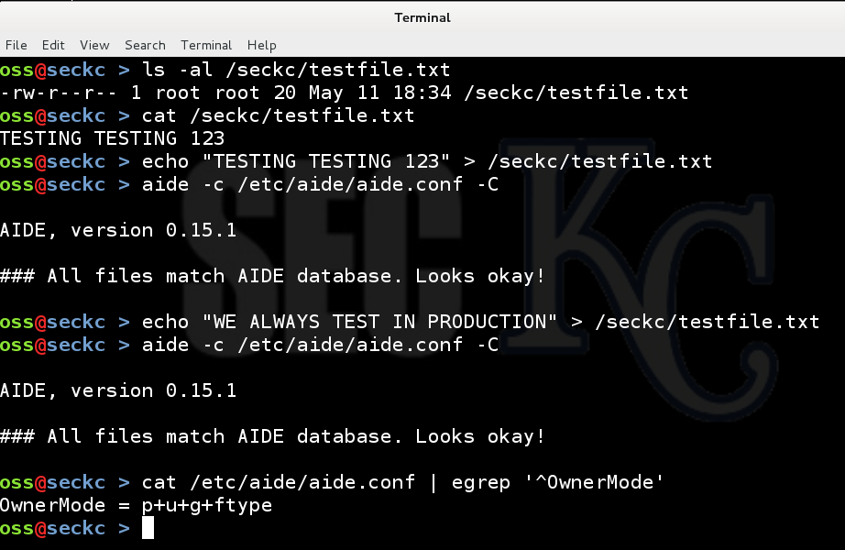
AIDE OWNER MODE

Slide 21
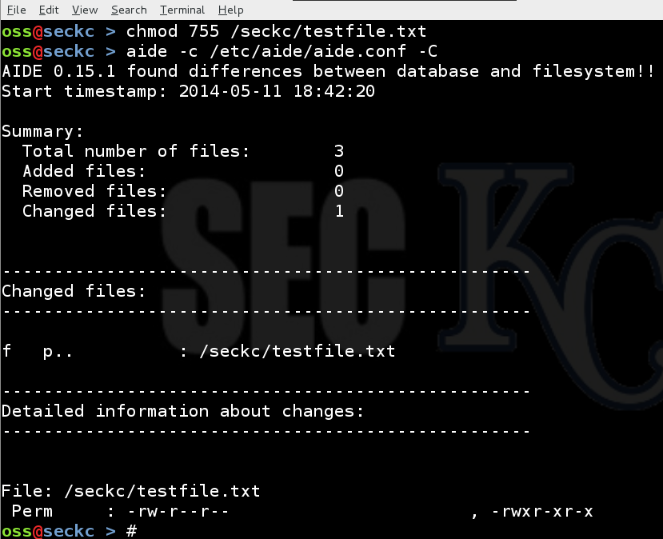
AIDE OWNER MODE

Slide 22


Slide 23
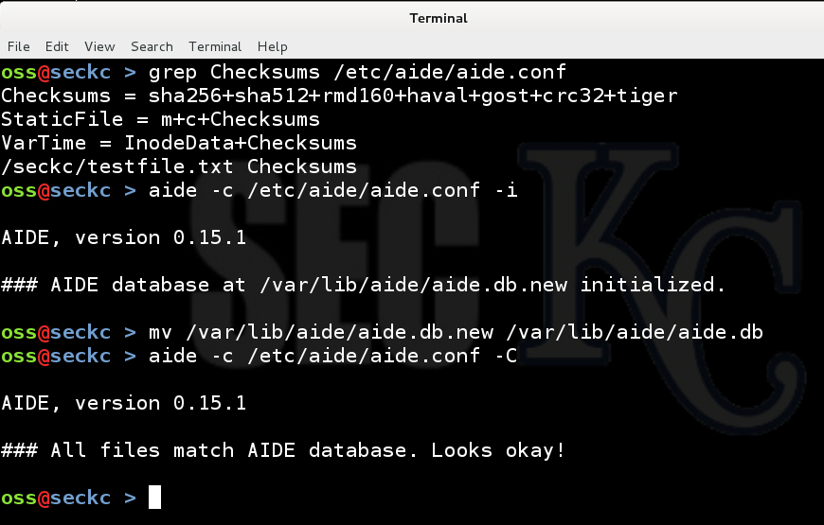
AIDE CHECKSUM MODE

Slide 24
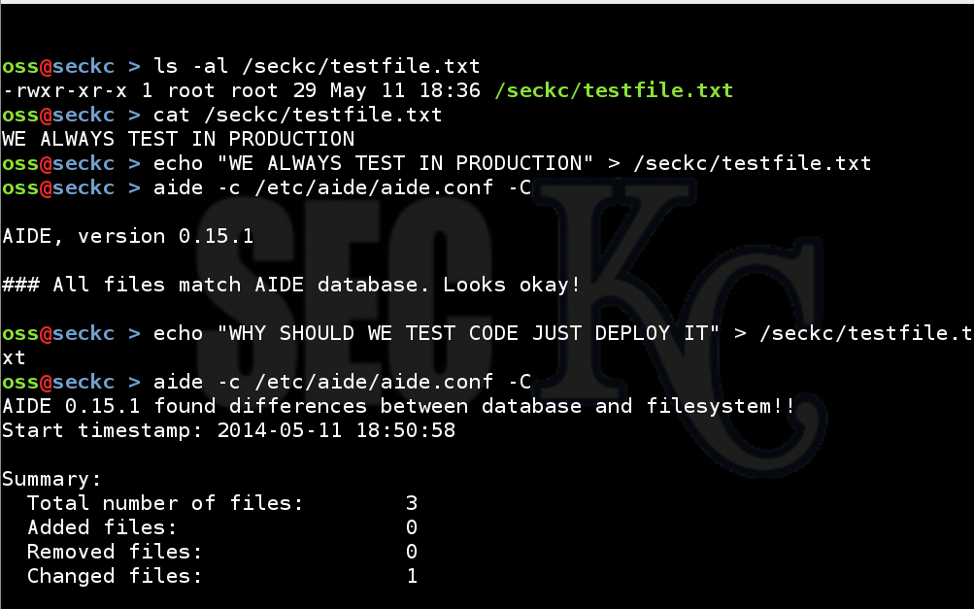
AIDE CHECKSUM MODE

Slide 25
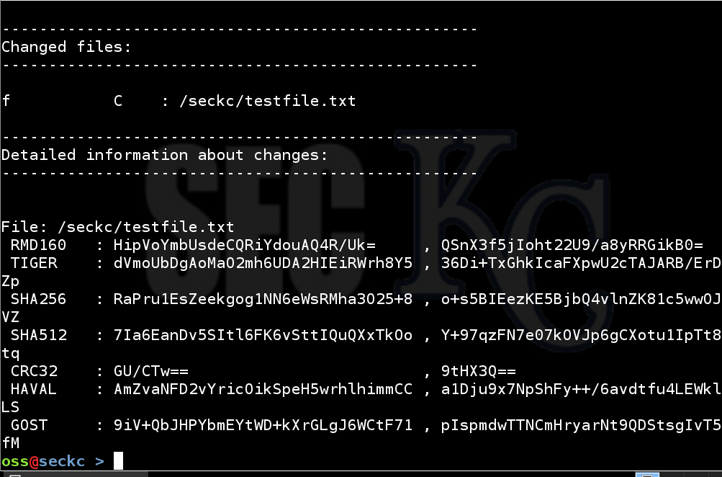
AIDE CHECKSUM MODE

Slide 26

TEST THE CONFIGURATION

Slide 27
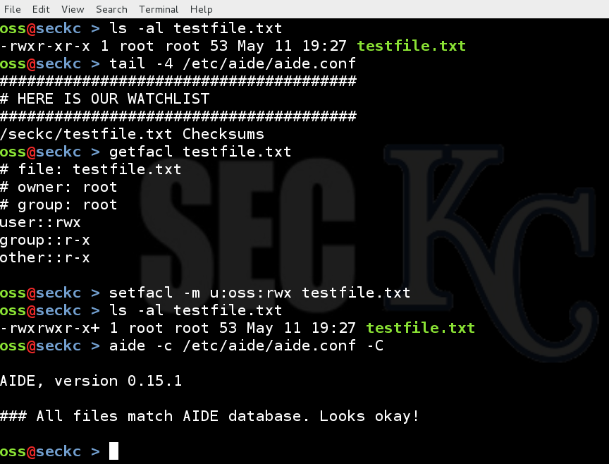
AIDE ACL EXAMPLE

Slide 28
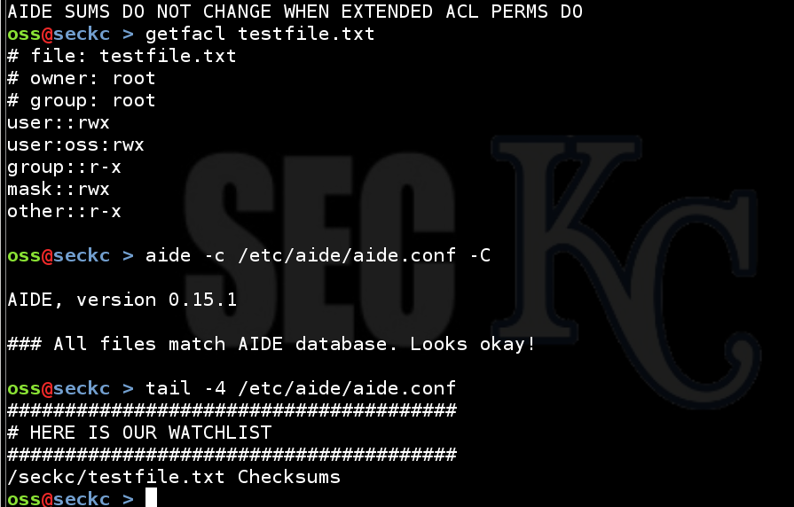
AIDE ACL EXAMPLE

Slide 29
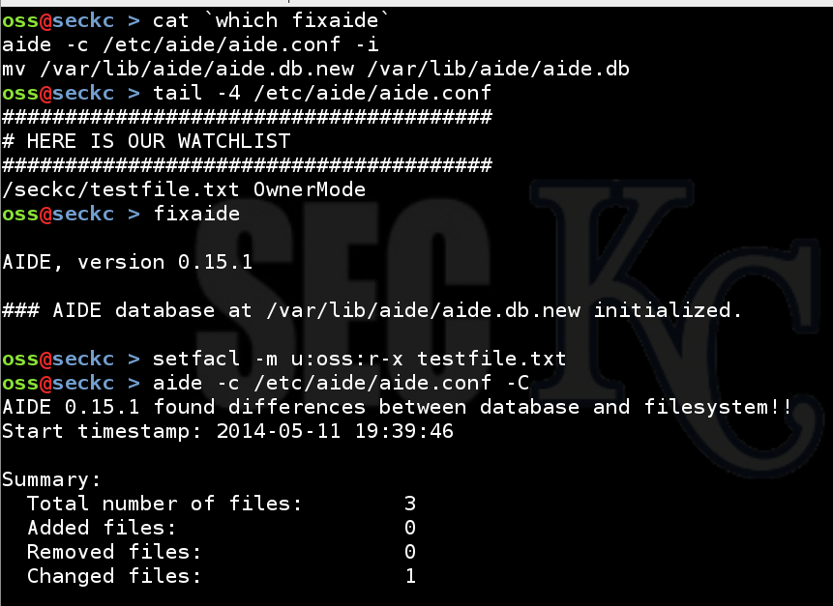
AIDE ACL EXAMPLE

Slide 30
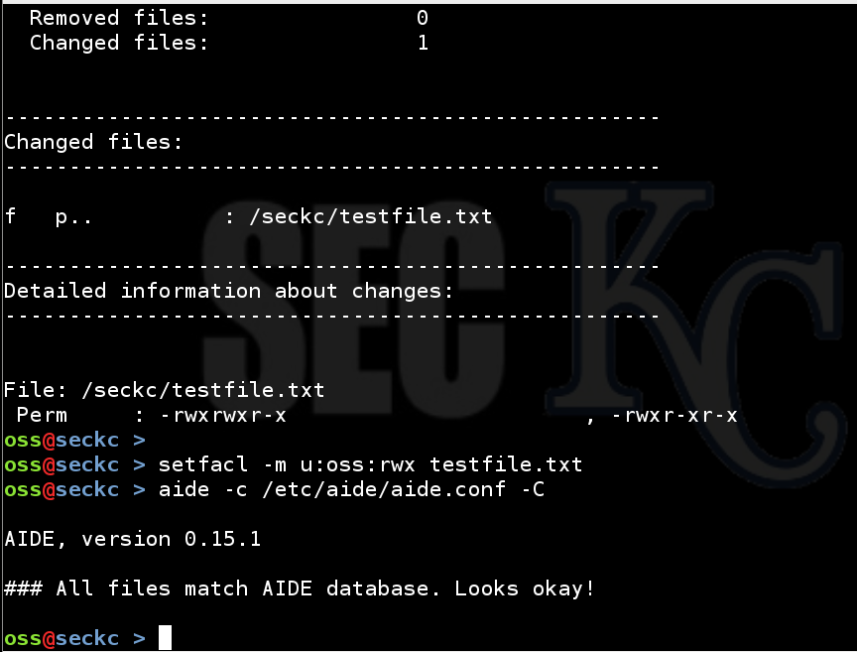
AIDE ACL EXAMPLE

Slide 31

Avoiding false positives
In the AIDE configuration file you can use the ! to prefix a directory or file path.
AIDE will ignore all files and directories prefixed with !

Slide 32
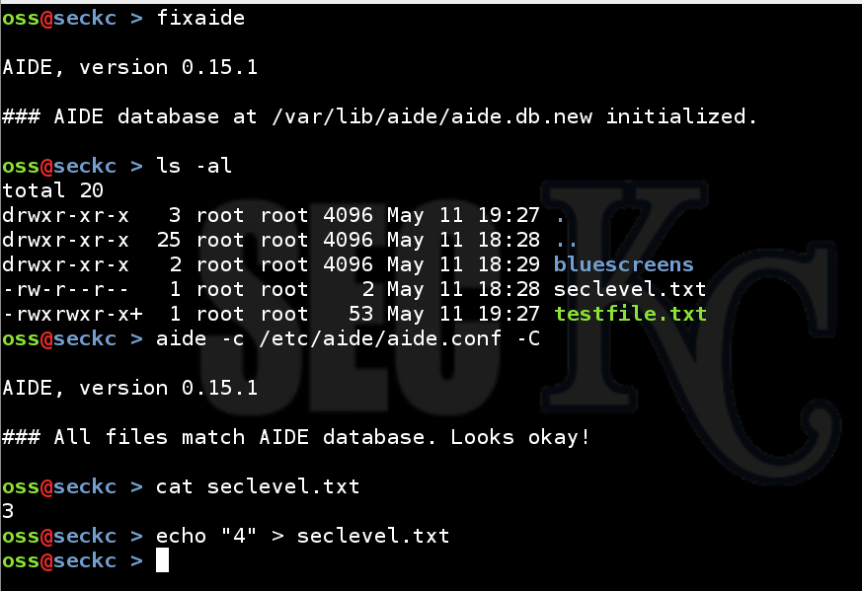
AIDE DIRECTORY CONFIG

Slide 33
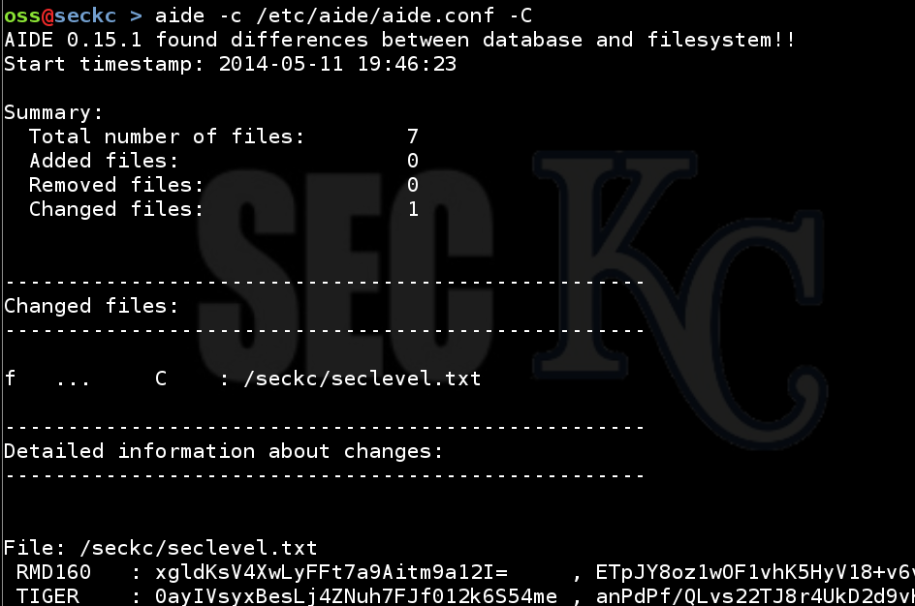
AIDE DIRECTORY CONFIG

Slide 34
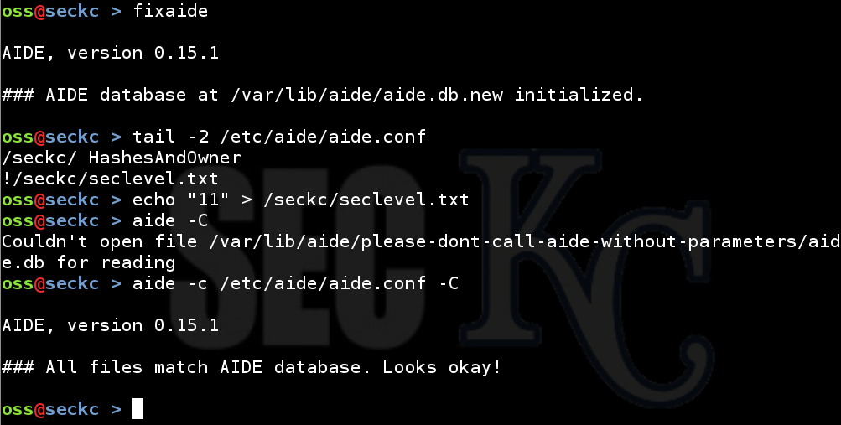
AIDE DIRECTORY CONFIG

Slide 35


Slide 36


Slide 37
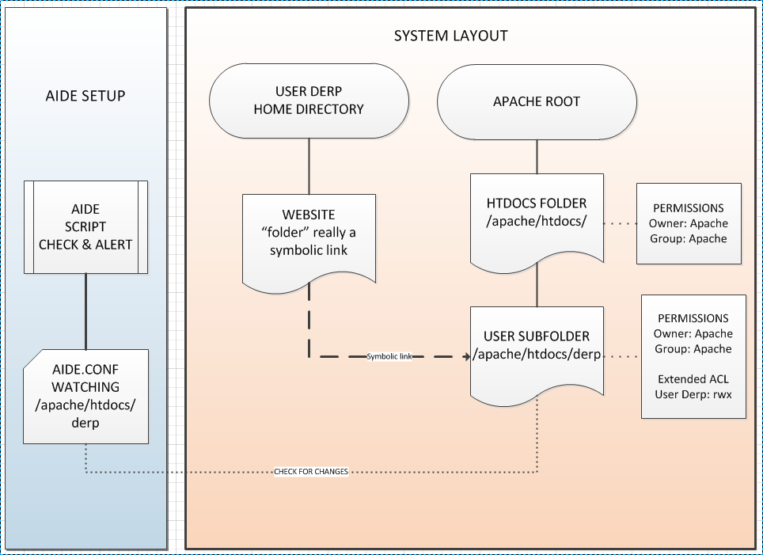

Slide 38
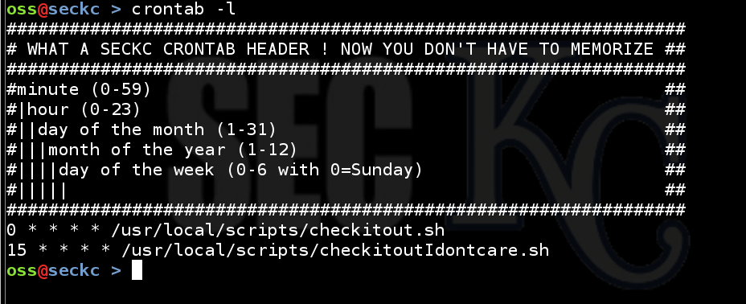
Wanna see my Crontab?

Slide 39
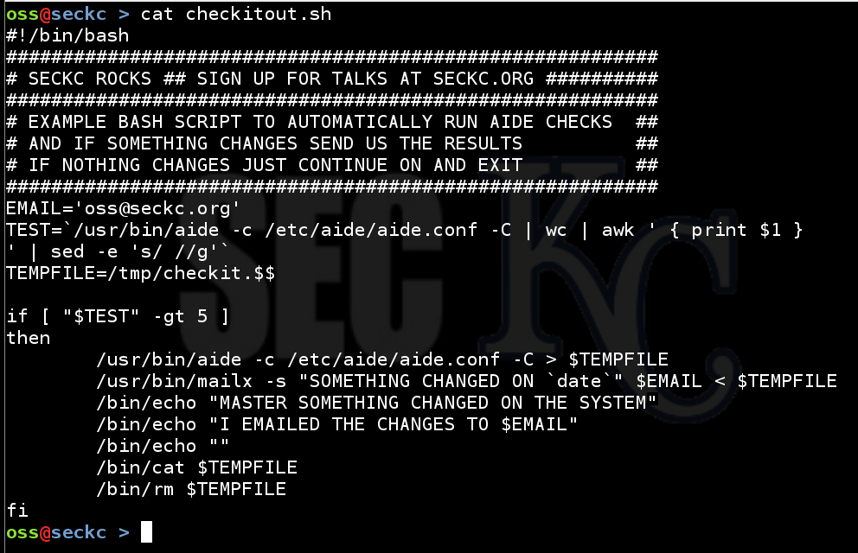
Using AIDE to Torment Others

Slide 40
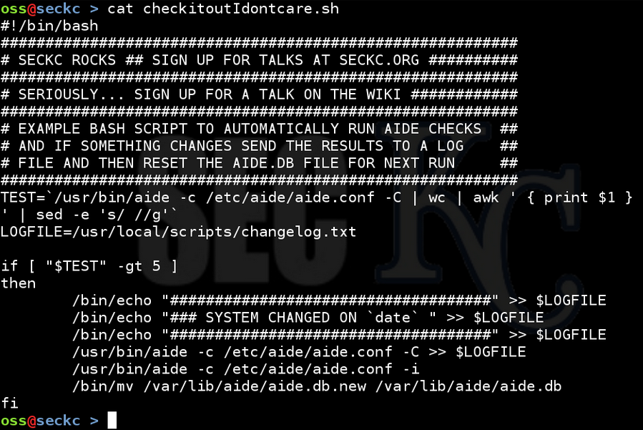
Using AIDE to Torment Others

Slide 41
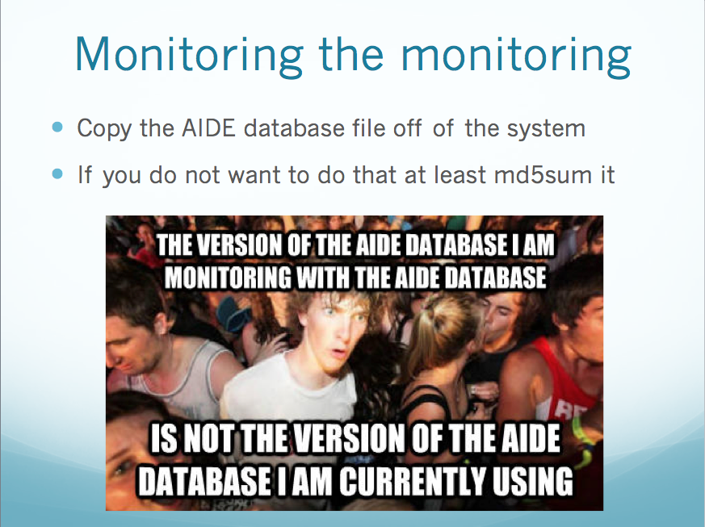

Slide 42


